Slide 1
Law Firm Finance: Is it Really a New Normal?
Mile High Chapter - ALA
Presented by Stephen M. “Pete” Peterson
September 20, 2012

Slide 2
Pete Peterson
Maxfield Peterson P.C.
Law Firm Biz
M 303-981-1118 pete@maxfieldpeterson.com

Slide 3
Favorite legal movie quotes; selected lines
“Here’s a dime. Call your mother. Tell her there’s serious doubt about your becoming a lawyer.”
“Somewhere, inside, in the dark, the firm is listening.”
“Everything that guy just said is bullshit. Thank you.”
“I hate lawyers; I just work for them.”
“You don’t want to quit me. I’m your dream client. I’m the most fun, I’m rich, and I’m always in trouble.”

Slide 4
Today’s agenda
Current and anticipated future trends affecting firm economics
Budget considerations for 2013
Keys to better profitability

Slide 5
Why is it called the New Normal?
In most business cycles, many of the "old ways" may no longer work and firms need to become more entrepreneurial and flexible to take advantage of the new economy.
Well, this line of thinking isn’t new.

Slide 6

Challenging times for the profession
Business model
Firm economics
Compensation structures
Competition; disruptors
Wag the Dog
Succession issues
War for market share/free agency partners
Law firm failures

Slide 7
In law firms….
Economic success (however defined) creates complacency
“If it ain’t broke, don’t fix it.”
“Our model has worked brilliantly for generations; why change”?

Slide 8
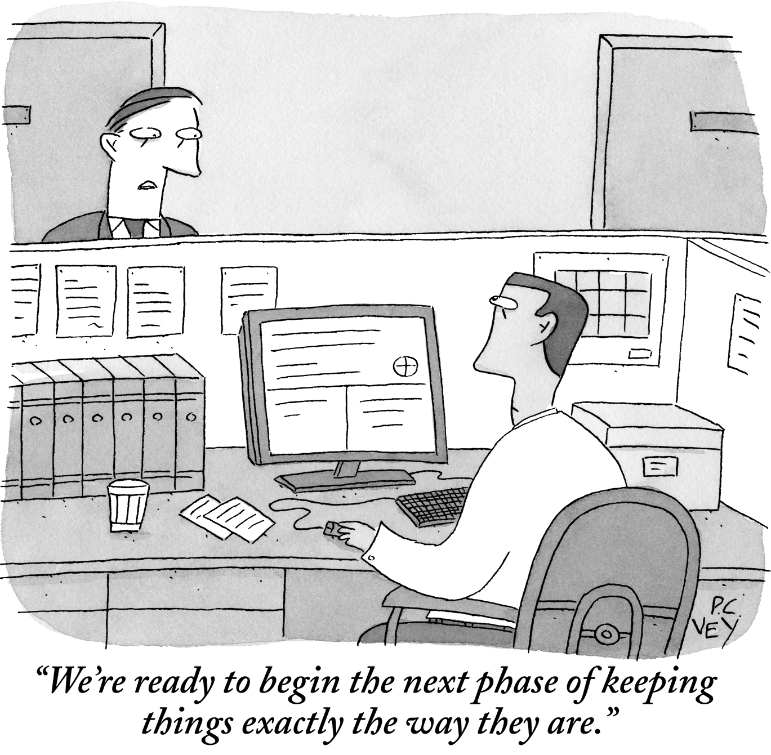
Business as usual
Reprinted with permission.

Slide 9
"Things may come to those who wait, but only what's left behind by those that hustle."
Abe Lincoln

Slide 10
Intolerable Cruelty (excess capacity)
Too many:
Law school graduates
Associates-given what clients will pay for
Of-counsel and non-equity partners, challenging the advancement of associates
Equity partners, if judged on strict performance criteria or amount of profits to go around

Slide 11
Wag the Dog
Clients forcing innovation

Slide 12
Clients forcing innovation
How we bill
Legal project management
Predictive coding

Slide 13
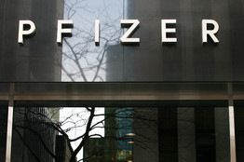
Alternative fee arrangements
Pfizer Inc., which spends more than $500 million a year on legal matters, says it expects to reduce its domestic law-firm spending by 15% to 20%, largely through flat-fee arrangements.
"I have told firms you cannot make your historical profit margins" on Pfizer work, said the pharmaceutical giant's general counsel, Amy Schulman.

Slide 14
Points of Law: Unbundling Corporate Legal Services to Unlock Value
HBR article July-August 2012
Opportunities for other firms.

Slide 15
Fee alternatives--litigation
Under what circumstances might each of the following be the right choice
  Associates review docs at rack rate?
  Use staff associates with rates 50% less?
  Use temp-agency attorneys and pass along cost (or cost plus) as client disbursement at roughly 25% of associate rate?
  Offshore LPO at roughly half the temp agency cost?
  Rely entirely on software tools?
    Predictive coding, etc.

Slide 17
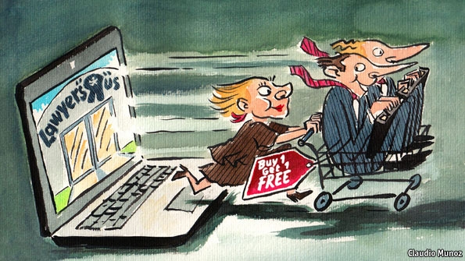
The Economist; 50 ways to leave your lawyer

Slide 18




Industry disruptors; start of the New Normal?
Cometh The Hour by Riverview Law
axiom
law redefined

Slide 19
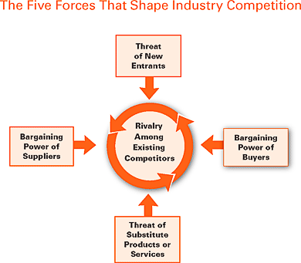
Source: Michael E. Porter

Slide 20
Succession Challenges
The future has already happened.

Slide 21
Median ages
Source: U.S. Census, ABA
?

Slide 22
Many financial considerations; example
Firm Capital

Slide 23
“For whom the gods would destroy, they first grant 40 years of business success.”
~Peter Drucker
What would happen if 10-15 firms failed in Denver next year?

Slide 24





Law firm failures
McDonough Holland & Allen

Slide 25
Law Firm Consultant Predicts ‘Absolutely’ More Layoffs and as Many as Five BigLaw Dissolutions

Slide 26
What about 800 pound gorillas?

Slide 27



Slide 28
Economic trends

Slide 29
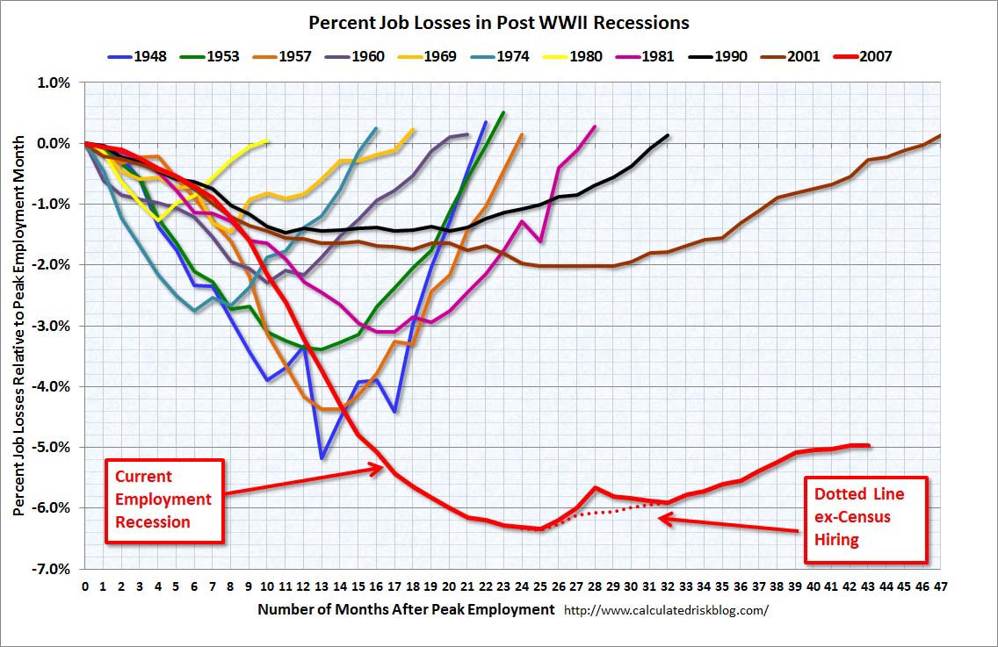
Recessions and period of time to job recovery

Slide 30
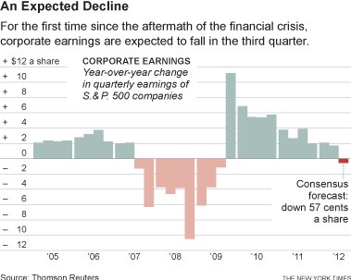
“Earnings in United States Are Beginning to Feel a Pinch.”

Slide 32
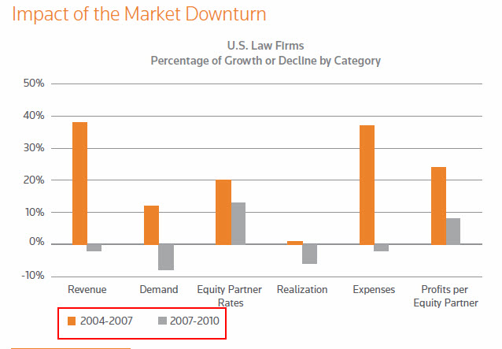

Slide 33
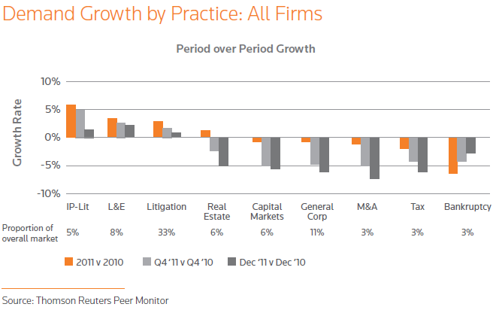
Practice trends-2011

Slide 34
Practice trends-Q2 2012

Slide 35
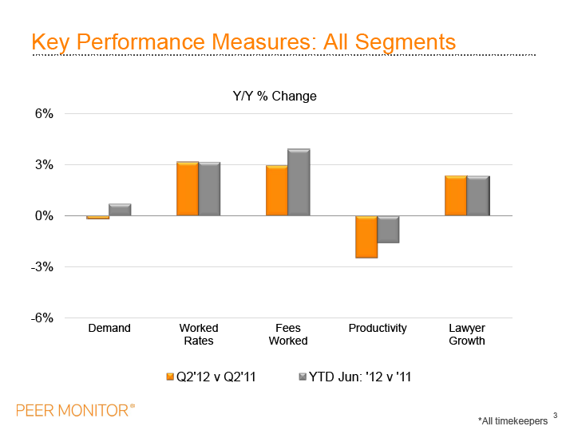

Slide 36
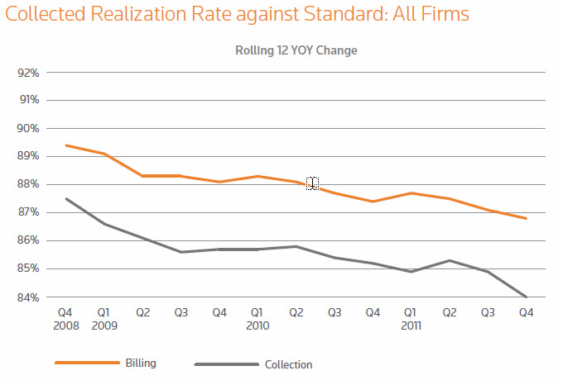

Slide 38
Ratio of staff to lawyers
Source: ALM Survey

Slide 39
No country for old practices
“We can't solve problems by using the same kind of thinking we used when we created them.”
A. Einstein

Slide 40
Law as a business: from Cohen & Grigsby’s website
All of our partners are expected to be productive, both in terms of billable hours and origination of business. There are no unproductive partners dragging down profits, nor is it a concern that the retirement of any senior director will jeopardize profitability.

Slide 41
BigLaw woes
Recent survey conducted by Wells Fargo’s Legal Specialty Group
Results through June 30, 2012
  Revenues increasing 3% YOY
  Expenses increasing 6.5% YOY
  Hourly rates up 3.7%
    Net 2.9% (erosion)

Slide 42
BigLaw woes (cont.)
Wells Fargo survey (cont.)
Firms are strengthening balance sheets
  Partner capital increased 7%
One in three firms have unfunded pension plans (primarily for partners)
Survey group; 115 firms in AMLAW200

Slide 43

Firms with PPP below $2m taking the hardest hit!

Slide 44
Budget considerations
Scenario plans
  Further belt tightening
  Loss of rainmakers
  Loss of clients
Impact from succession planning
  Reduced productivity
  Deferred income
  Return of capital
Lateral hires
Consider tools like Time Builder

Slide 46
Budget considerations (cont.)
Zero based budgeting
Increase budget for business development
  Including training, coaching, sales programs
  Track ROI
Merger activity-many considerations
Risk management
Contingency line item
What else can be outsourced
Increase budget for internal controls

Slide 47
Seeking lower cost solutions
Offsite service centers
Bingham (Boston) to Lexington KY
Pillsbury (NYC) to Nashville TN
WilmerHale (Boston/WDC) to Dayton OH
Orrick (SF) to Wheeling WV
Overseas based outsourcers have centers in Fargo and Dallas

Slide 48
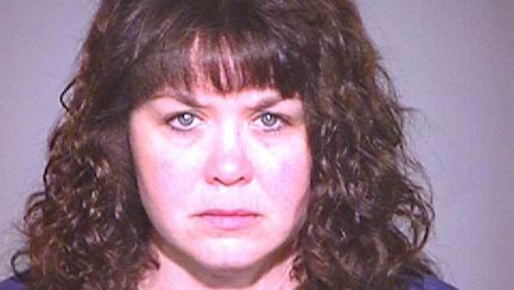

Lack of internal controls
Next-former Mayer Brown CIO charged with embezzlement.

Slide 49
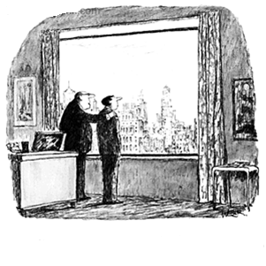
Keys to increased profits
Get the work
Do the work
Bill the fees
Collect the fees
Return to step 1
Somewhere out there, Dean, is the key to increased profits. I want you to find that key, Dean, and bring it to me.

Slide 50
Keys to increased profits (cont.)
Revenue
Utilization
Leverage
Expenses
Speed
The New Normal?

Slide 51
Other helpful (?) advice
What law firms can Learn from organized crime.
What Steve Jobs can teach law firms about marketing.
What law firms can learn from my disappointing experience at Del Frisco's in New York.
The 'Moneyball' lesson for firms.
Risky Business: What law firms can learn from airlines and hospitals.

Slide 52
Wanna get away?

Slide 53
Questions/comments

